Slide 1
Quick Start Guide for the NCFL’s FOM System
Last Updated: 2022-09-09

Slide 2
Facility Online Manager (FOM)
The NCFL uses the Facility Online Manager (FOM) system to track instrument usage. Users must use FOM to book time on an instrument both for training and collecting data. This guide provides a quick start for using FOM and touches on the following:
How to sign up for FOM as a first-time user
How to add a purchase order (PO) account number to your FOM account
How to sign up for training on an instrument
How to sign up for instrument time
How to contact NCFL staff
More thorough information on FOM is available in the full user manual, accessible here.

Slide 3
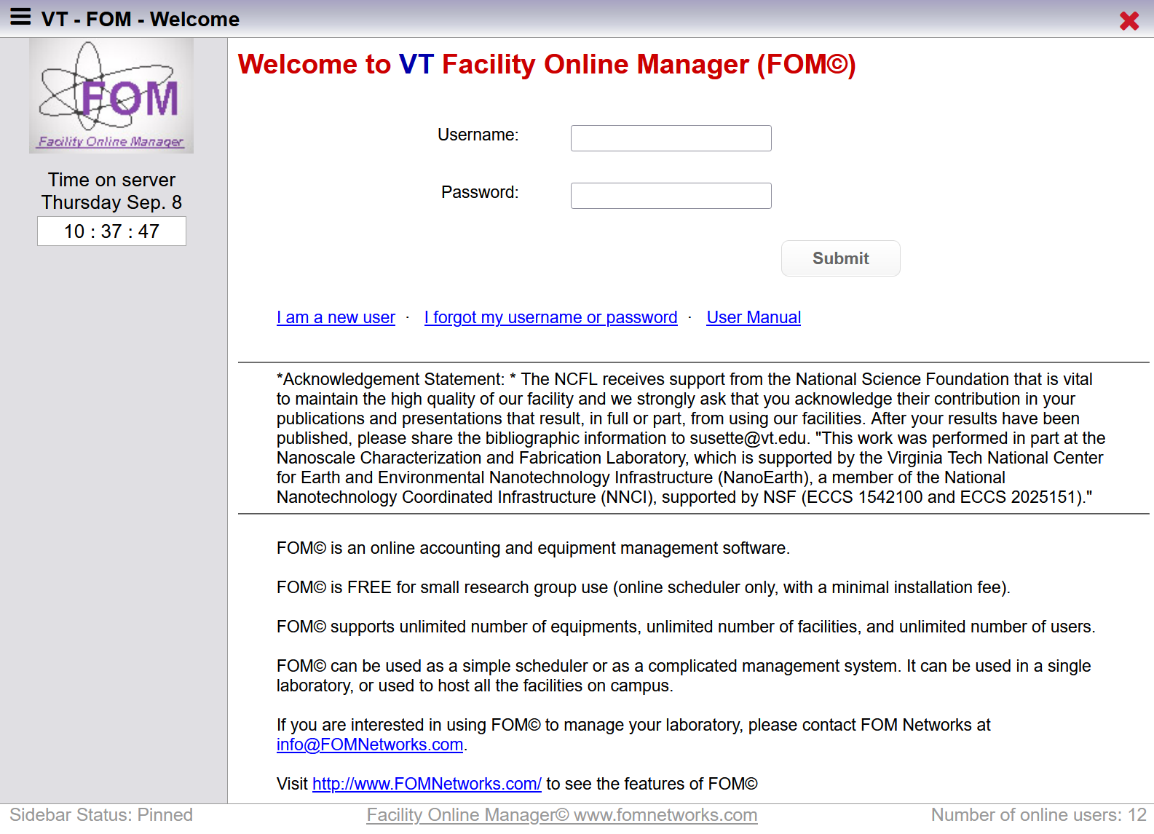
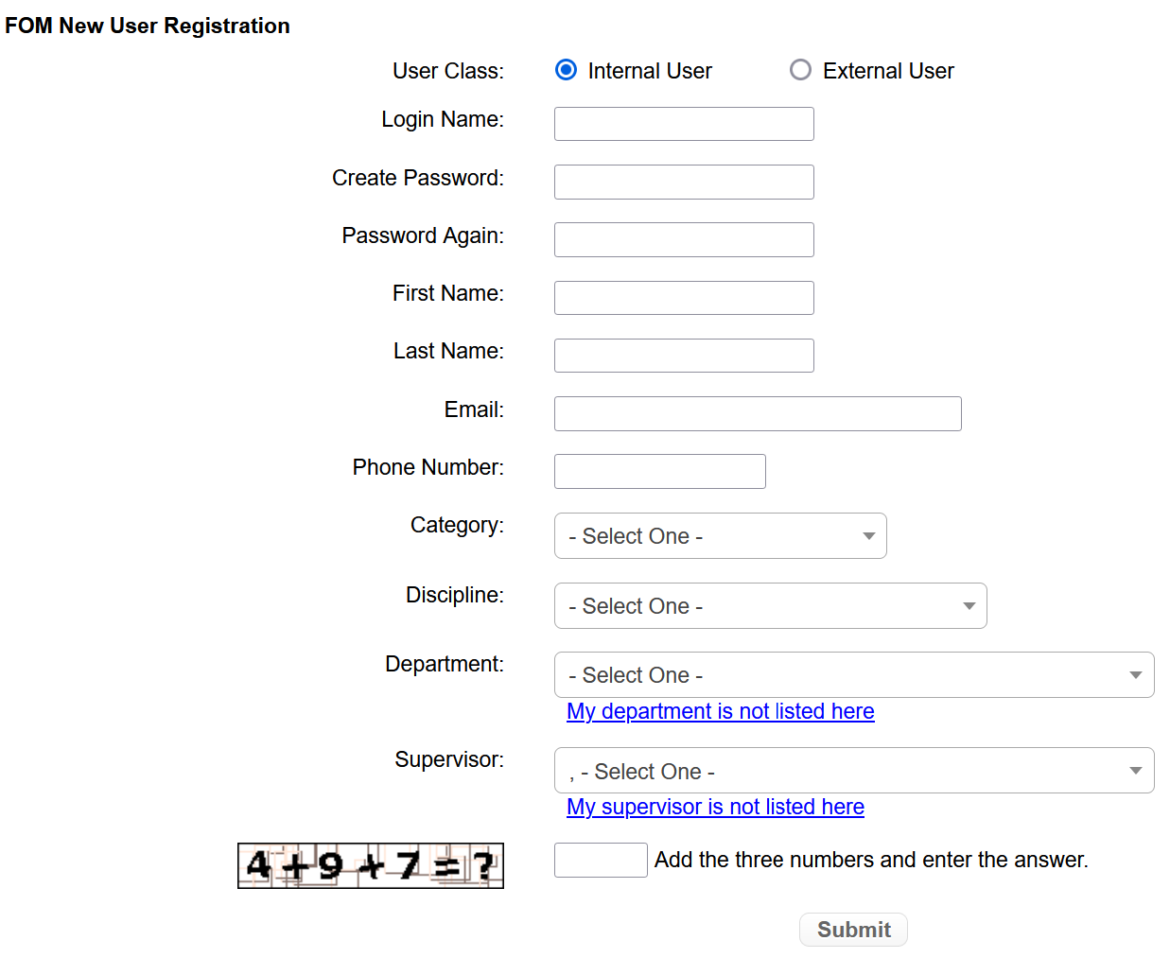
Signing Up for FOM
First-time users of FOM must create an account to access the system.
Go to the FOM website, and select “I am a new user”.
Fill in the fields in the “FOM New User Registration” window, then select “Submit”.

Slide 4
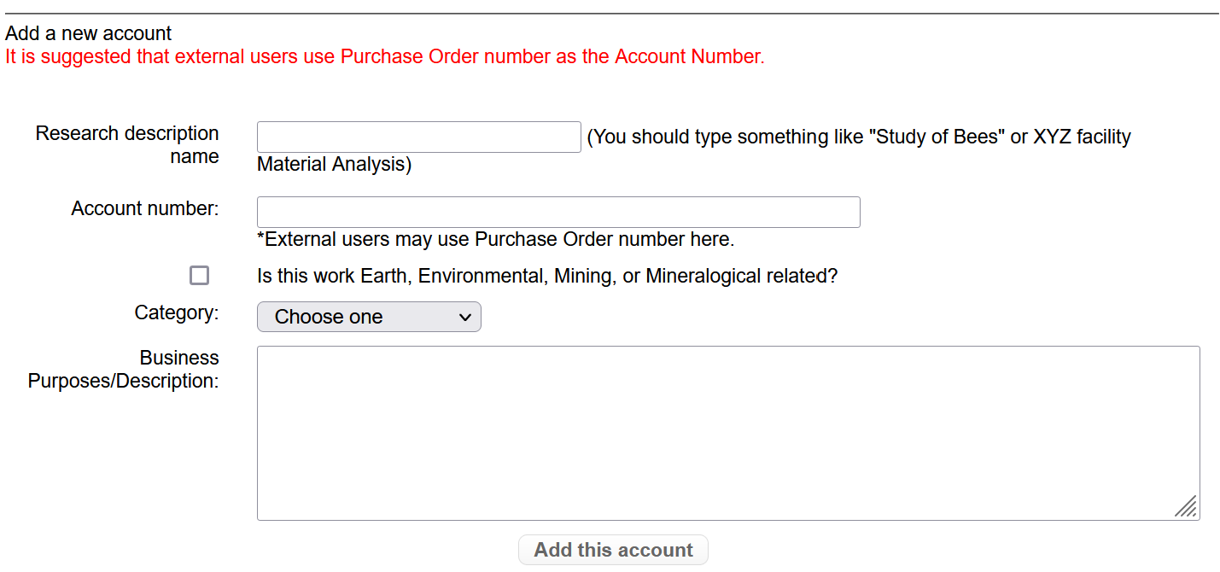
Adding a Purchase Order (PO) Account Number
To reserve time on an instrument, including for training, you must have an active PO in FOM. Note: POs close out at the end of every month. To get a PO through HokieMart, follow the instructions here.
Log into FOM using your user credentials.
Select “My Accounts”.
Fill in the fields in the “Add a new account” section, then select “Add this account”.
To avoid confusion with multiple POs for a given project, add a month and year designation to the “Research description name”—e.g., Study of Bees Sept 2022.

Slide 5
Signing Up For Training
Prior to using an instrument on your own, you must train with the lab manager overseeing that instrument. Each instrument requires a different number of training sessions, which will depend on the data you are interested in collecting. Note: Some lab managers also require you to reserve time in their personal calendars within FOM for the training sessions in addition to booking instrument time.
On the Home page, select “Apply access to new resource”.

Slide 6
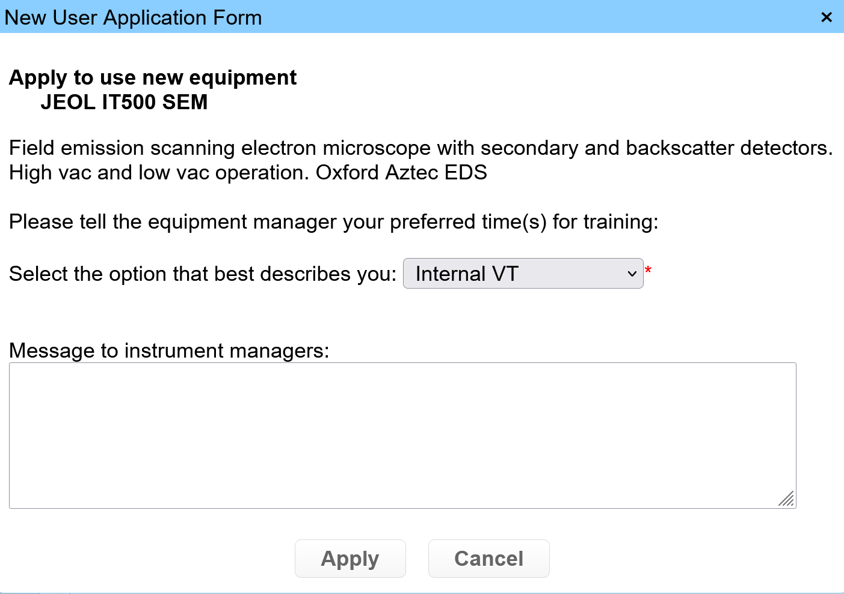
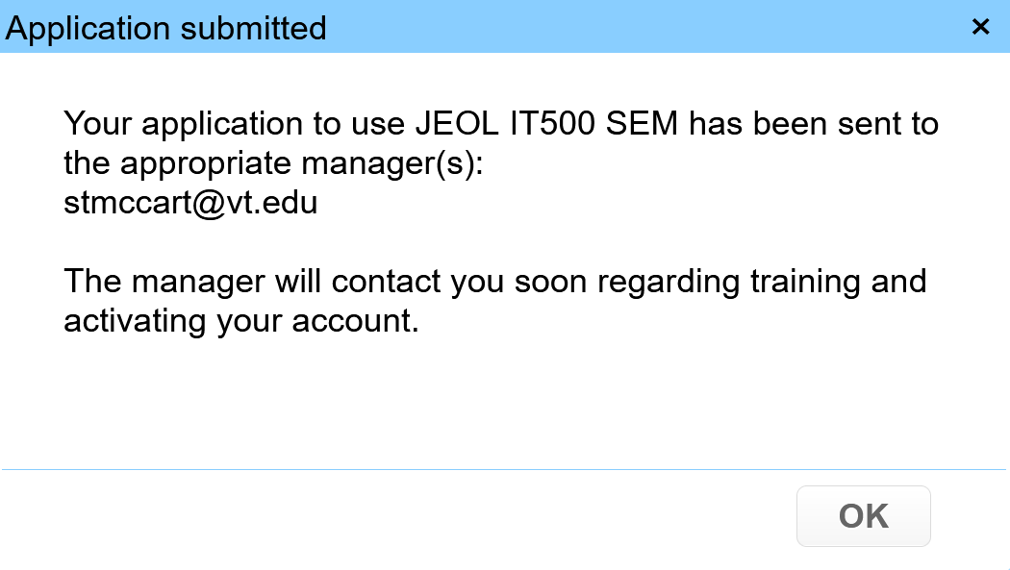
Signing Up For Training (continued)
Find and select the instrument you want to be trained on under “NCFL”.
Fill in the fields in the “New User Application Form” window, then select “Apply”.
Select “OK” in the “Application submitted” pop up window.

Slide 7
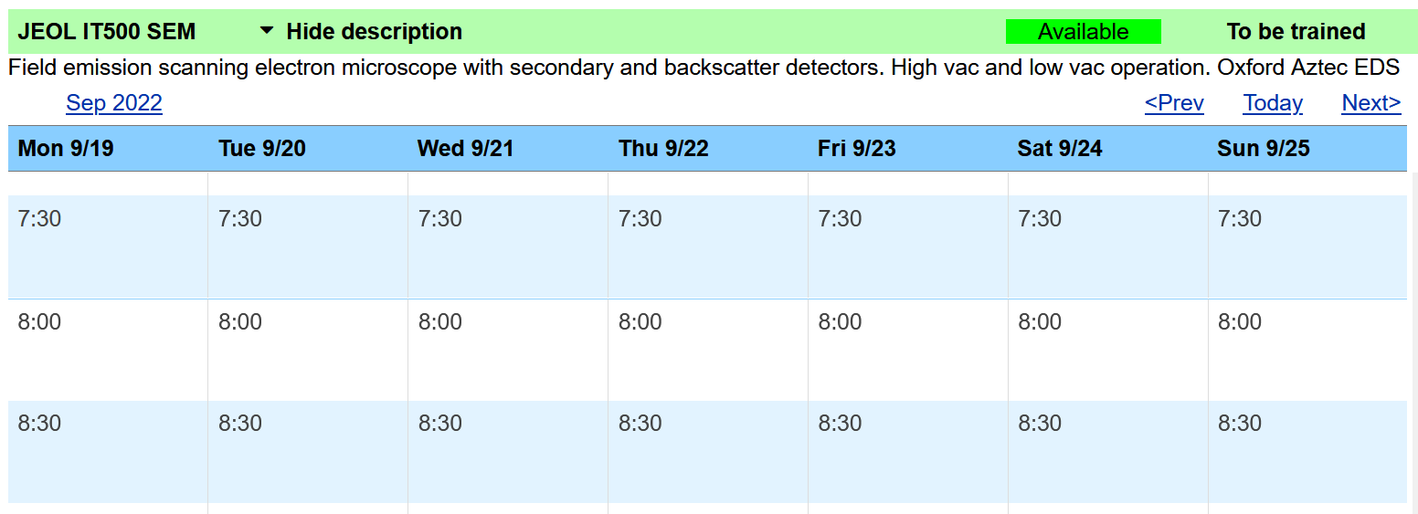
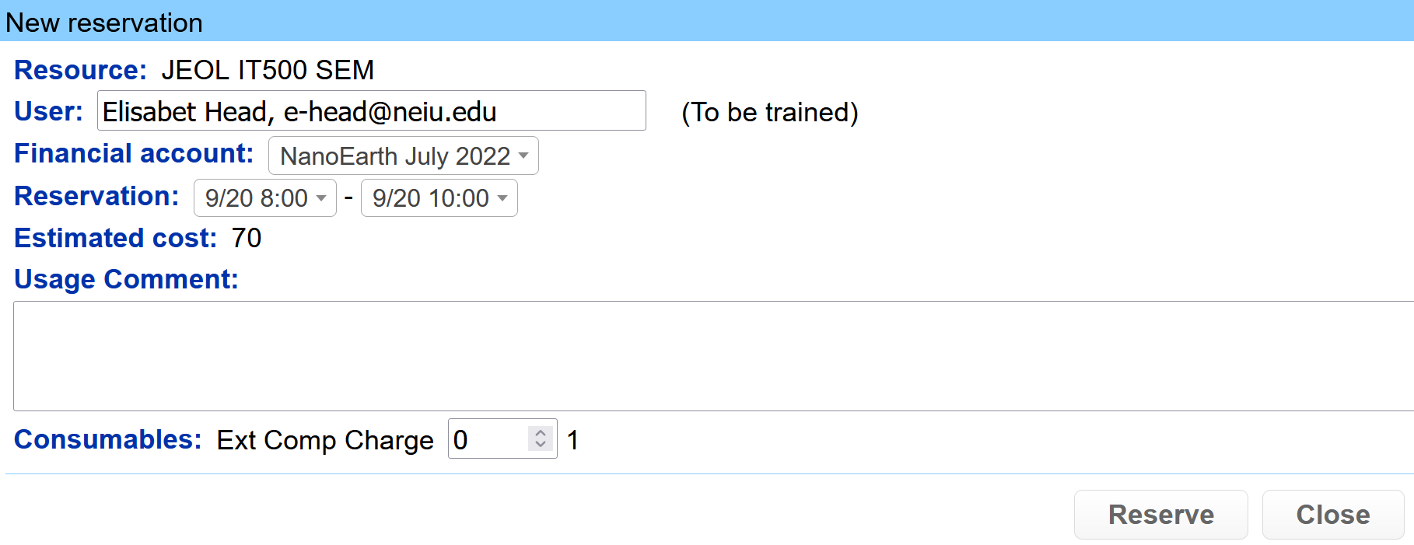
Signing Up For Training (continued)
After reloading FOM, the instrument of interest will appear on your Home page. Select the instrument calendar by clicking on its name.
Click on the calendar to choose a date and time for your first training session.
Fill in the fields in the “New reservation” window, then select “Reserve”.

Slide 8
Signing Up For Instrument Time
Once you have been trained on an instrument, the lab manager will give you access to the instrument within FOM. This will allow you to sign up for time on your own.
On your Home page, select the instrument calendar by clicking on its name.
Click on the calendar to choose a date and time for your session(s).
Fill in the fields in the “New reservation” window, then select “Reserve”.

Slide 9
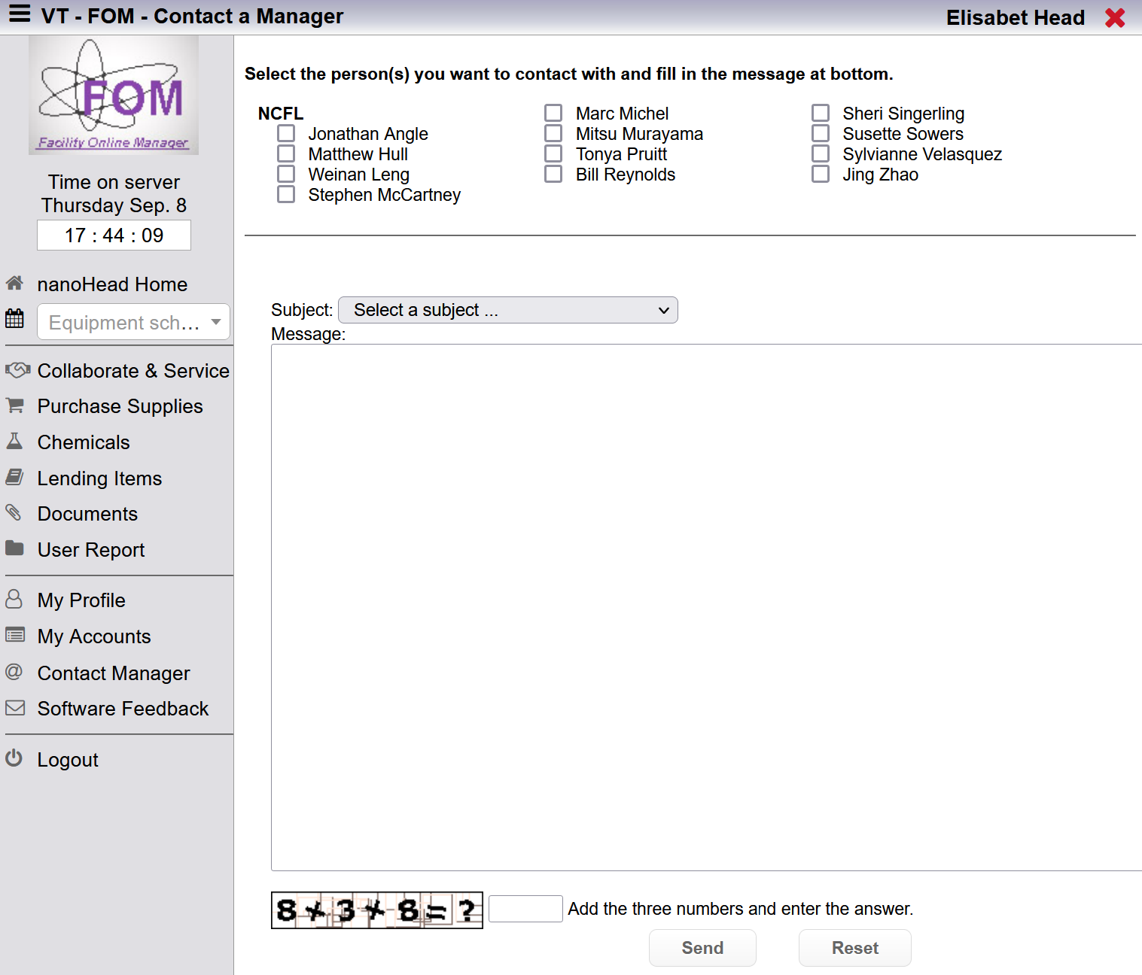
Contacting NCFL Staff
It is best to communicate with NCFL staff through FOM. This will ensure that you receive a prompt response. Please avoid sending individual emails to NCFL staff.
To send a message to NCFL staff, select “Contact Manager”.
To see the roles of current staff, visit the NCFL website.
Select the person(s) of interest, choose a subject, enter your message, and select “Send”.

